Slide 1

Programming Principles
1811ICT/2807ICT/7001ICT
Week 9 Lecture
Dr Mardé Helbig

Slide 2
important information
Quiz2

Slide 3

Quiz2 information
Quiz 2 takes place in Week 10 on 25 September
Quiz 2 will be available on 25 September 6am-11:59pm
Start at the latest at 10:30pm to ensure you have enough time
It has 2 parts:
Part 1 is 1 hour 15 minutes (we gave 15 minutes extra)
Part 2 is 15 minutes, asking questions about problems you solved in Part 1
It covers all work of Sections 1-20 on Canvas course site, live lectures of Weeks 1-8 and Workshops 1-8
There is a sample quiz on the course site to see the type of questions to expect and how to access Part 2
If you cannot write Quiz 2 on that day, you must apply for extension with the appropriate evidence
Demo on Course Site

Slide 4
complex data structures
Recap

Slide 5

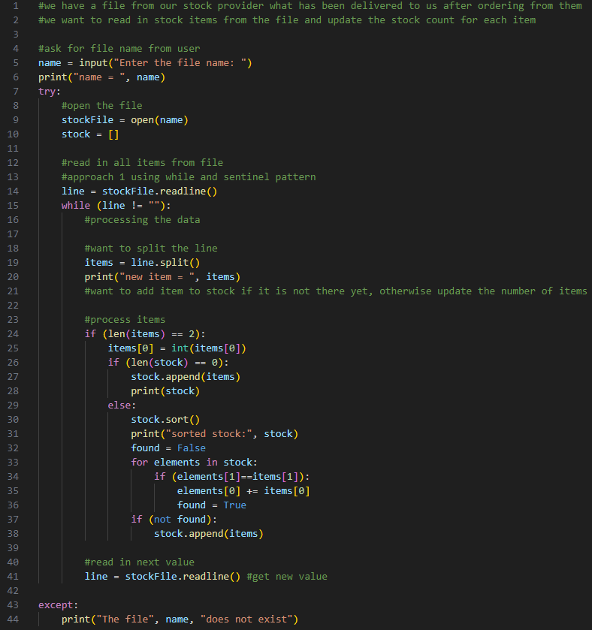
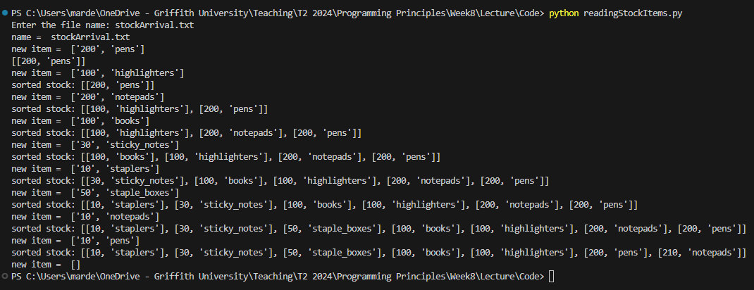

processing file data
Show changing while to for loop

Slide 6

Any questions?
Type your question in the Q&A or raise your hand

Slide 7







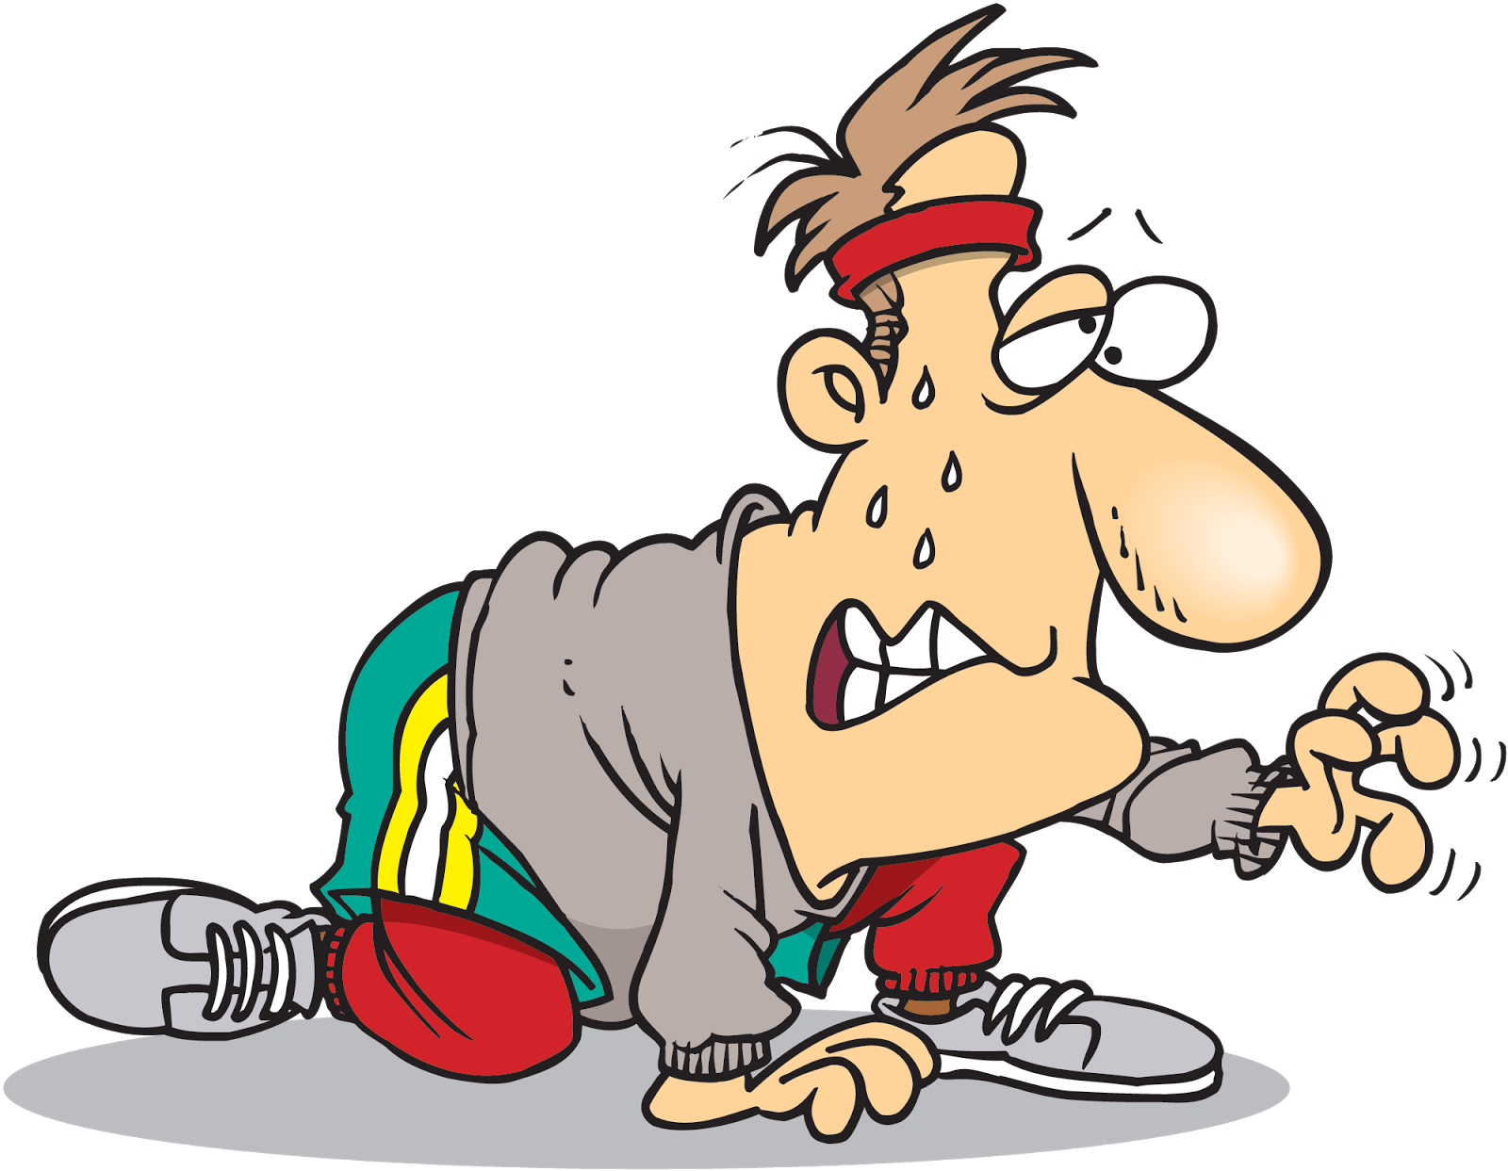




Temperature Check
How do you feel about the upcoming Quiz2?

Slide 8
complex data structures
Sections 22: set concepts

Slide 9

sets
Collection of distinct/unique objects
No duplicates
An object can either be in a set or not in a set
Order is not kept and does not matter
Represented in various ways:
elements
A
200
set name
A = {3, 200, 59}
3
59
Venn-diagram

Slide 10
empty sets
No elements
A = {}
A
Venn-diagram

Slide 11
set notations and operations
Suppose we have 2 sets:
A = {1, 3, 200, 599}
B = {3, 40, 59, 200, 650}
A
B
1
40
3
650
Sets A and B overlap
200
599
59

Slide 12

union
Suppose we have 2 sets:
A = {1, 3, 200, 599}
A $∪$ B = {1, 3, 40, 59, 200, 599, 650}
B = {3, 40, 59, 200, 650}
Union of A and B/Joining of A and B
All elements of A and B
No duplicates!
A
B
1
40
3
200
650
599
59

Slide 13

intersection
Suppose we have 2 sets:
A = {1, 3, 200, 599}
A $∩$ B = {3, 200}
B = {3, 40, 59, 200, 650}
Intersection of A and B
All elements that are in A and B
No duplicates!
A
B
1
40
3
200
650
599
59

Slide 14

difference
Suppose we have 2 sets:
A = {1, 3, 200, 599}
A $−$ B = {1, 599}
B = {3, 40, 59, 200, 650}
Difference of A and B
All elements that are in A and not in B
B
A
1
40
3
200
650
599
59

Slide 15
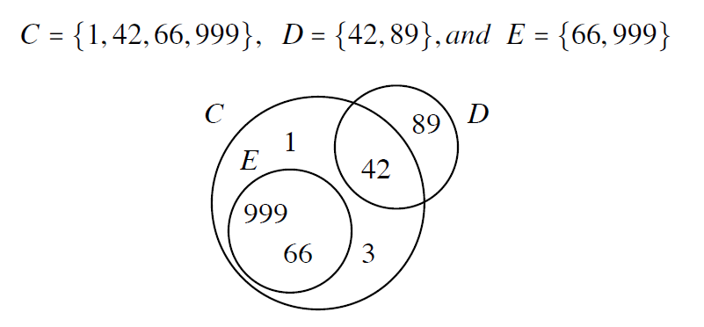
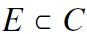
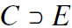
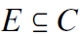
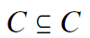
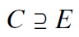
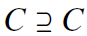
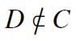

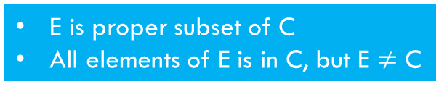
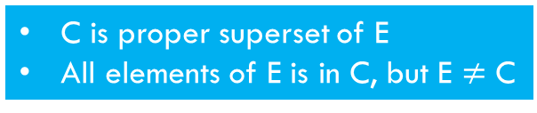
Subsets
Consider the following sets:
E is proper subset of C
All elements of E is in C, but E $≠$ C
C is proper superset of E
All elements of E is in C, but E $≠$ C
E is subset of C
All elements of E is in C
C is superset of E
All elements of E is in C
Why?

Slide 16
Any questions?
Type your question in the Q&A or raise your hand

Slide 17
Temperature Check
How do you feel about the concepts of sets?

Slide 18
complex data structures
Sections 23: sets in python

Slide 19
sets
Python has a set class
Collection of unique elements
Sets are mutable – can add/remove elements
Elements within sets are immutable

Slide 20
set operations
Python | Description
set() | Create an empty set, cannot use {}
set(sequence) | Create a set of values from the sequence
s.add(x) | Add x to the set s
s.remove(x) | Remove x from the set s
len(s) | Count the number of elements in s
x in s | Is x in (an element of) the set s?
x not in s | Is x not in (not an element of) the set s?

Slide 21
set operations (cont.)
Python | Description
s.union(t) s | t | Form the union of sets s and t
s.intersection(t) s & t | Form the intersection of sets s and t
s.difference(t) s - t | Form the difference of sets s and t
s.issubset(t) s <= t | Is s a subset of t?
s < t | Is s a proper subset of t?
s.issuperset(t) s >= t | Is s a superset of t?
s > t | Is s a proper superset of t?

Slide 22
set operations (cont.)
Python | Description
s.isdisjoint(t) | Are s and t disjoint?
s.pop() | Return and remove a random element from s
s.clear() | Remove all elements from s
Demo code example of set

Slide 23

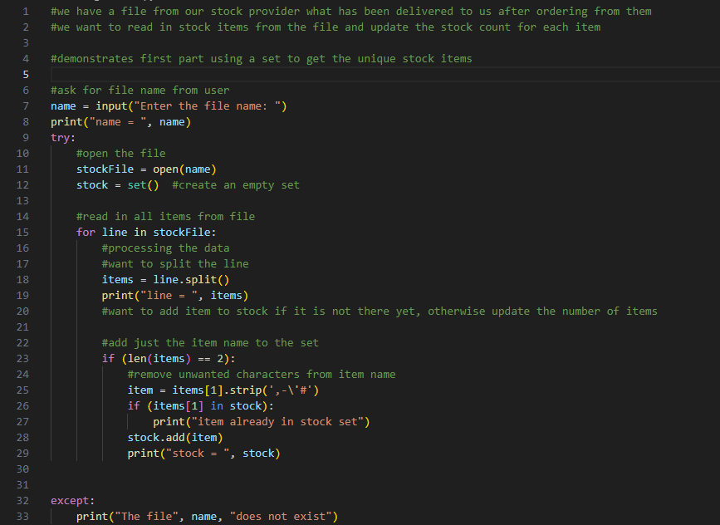
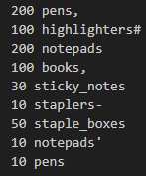
using sets in python
Solving this problem using different collections
stockArrival2.txt

Slide 24
Any questions?
Type your question in the Q&A or raise your hand

Slide 25
Temperature Check
How do you feel about sets?

Slide 26
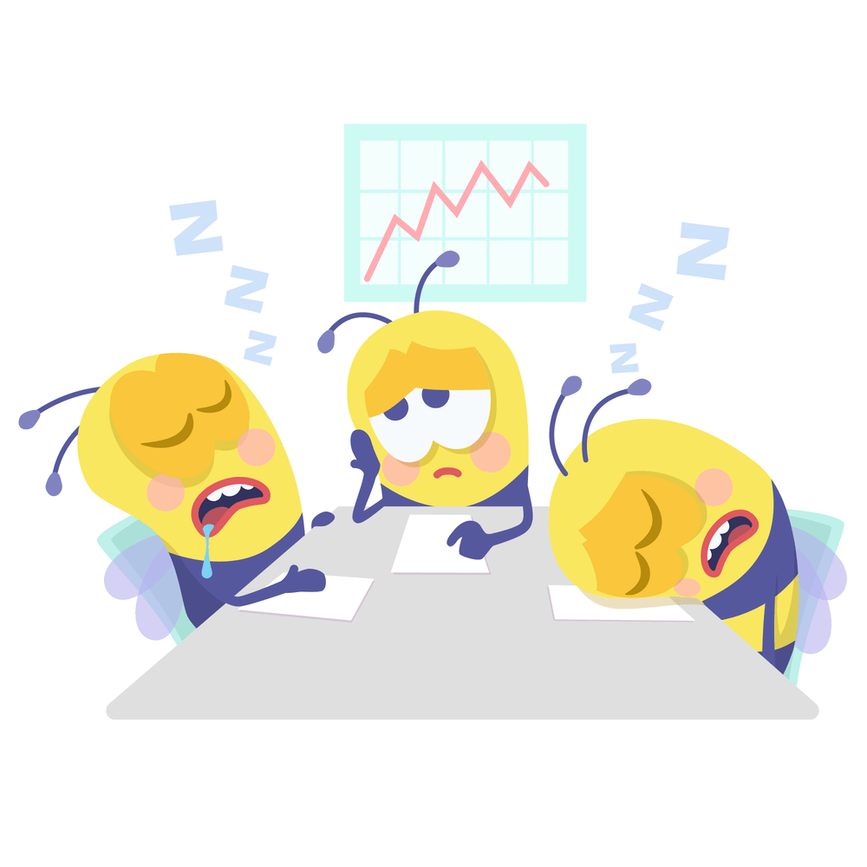
5 Minute Break Time!
Start again at 12:10

Slide 27
complex data structures
Sections 24: dictionaries in python

Slide 28
dictionaries
Sets are amazing to use for keeping a collection of unique elements
But, elements are immutable
Using dictionaries (maps in other programming language)
How can we update the count of the stock items?

Slide 29
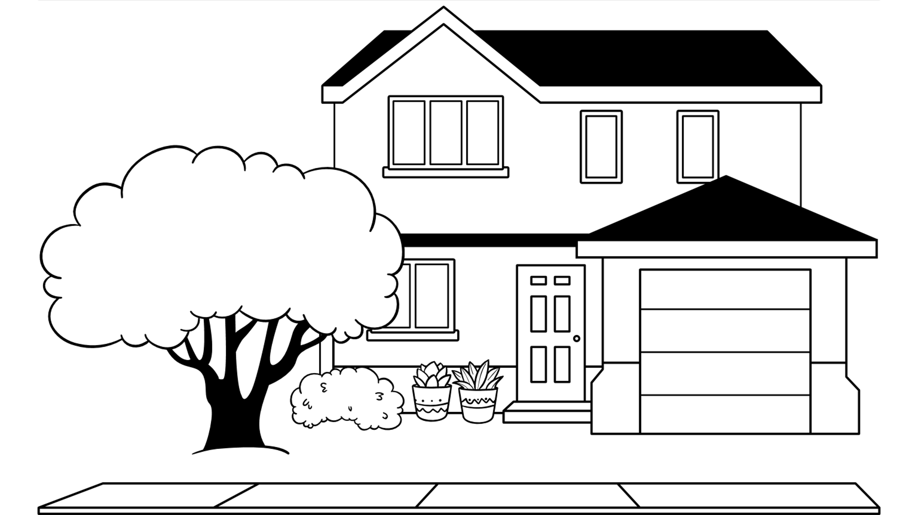

dictionaries
dict class in Python
Similar to a set, but each element has 2 values:
Unique key, immutable
Associated value (doesn’t have to be unique), mutable

Slide 30
dictionaries: creating non-empty
Python | Description
{} dict() | Create an empty dict
{key1:value1, key2:value2, ...} | Create a dict where each element is a key-value pair and separated by a ‘,’. The key and value of an element are separated by a ‘:’.
dict({key1=‘value1’, key2=‘value2, ...}) | Create a dict with the constructor using keys and values as the arguments
dict([(key1, value1), (key2, value2)]) | Create a dict with the constructor using keys and values as a list of tuples of length 2
dict([[key1, (value1a, value1b)], [key2, (value2a, value2b)]]) | Create a dict with the constructor using keys and values as a list of lists of length 2, with the nested list containing keys and values as tuples of length 2

Slide 31
dictionaries: updating/adding values
Python | Description
d = dict() d[key1] = value1 | Add/replace value1 associated with key1in dict d
d.update(d2) | Update dict d with the data in dict d2

Slide 32
dictionaries: extracting data
Python | Description
seq = d.keys() | Return a sequence of all keys in d
seq = d.values() | Return a sequence of all values in d
seq = d.items() | Return a sequence of tuples containing all the keys and values in d
sorted(seq) | Sorts the sequence seq

Slide 33
dictionaries: removing data
Python | Description
del d[key1] | Delete key key1 from d
d.clear() | Remove all keys from d

Slide 34
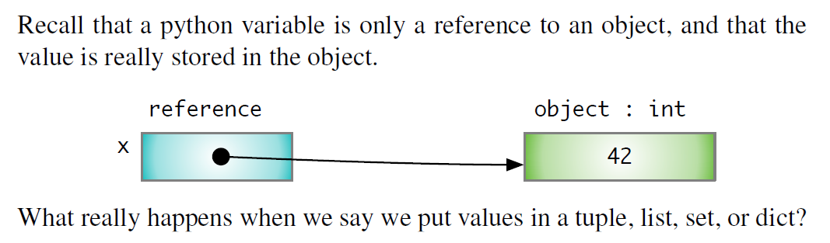
collections and references

Slide 35
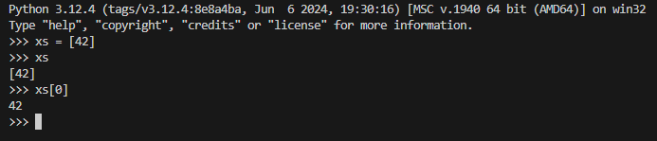
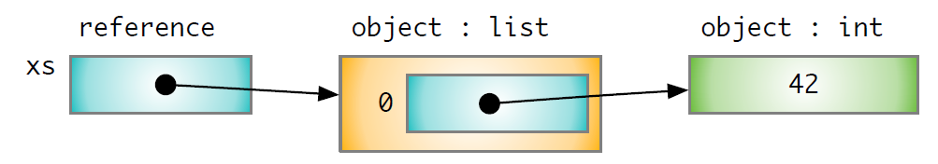
collections and references

Slide 36
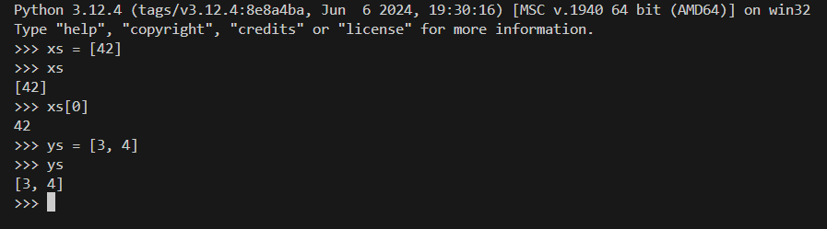
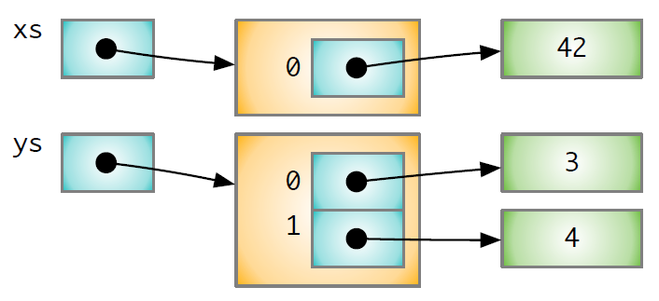
collections and references

Slide 37
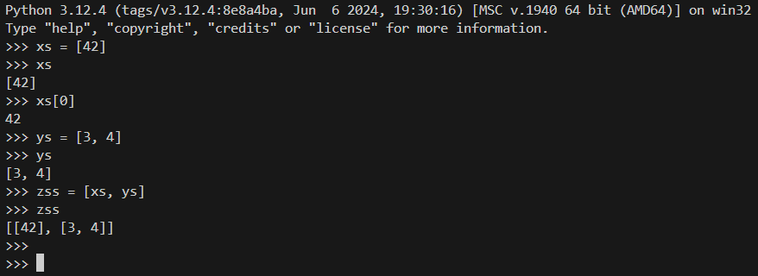
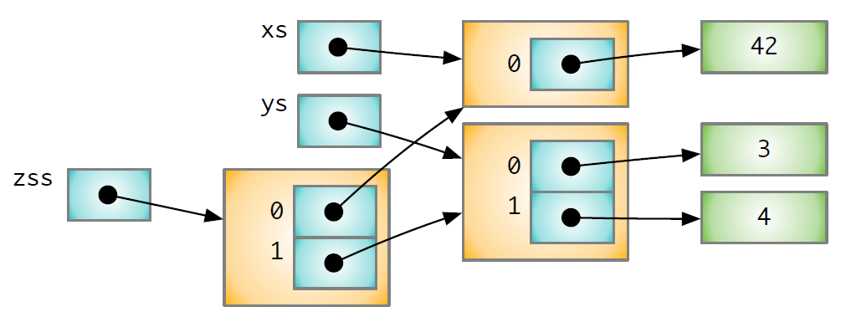
collections and references
What happens to zss if we make changes to ys?

Slide 38
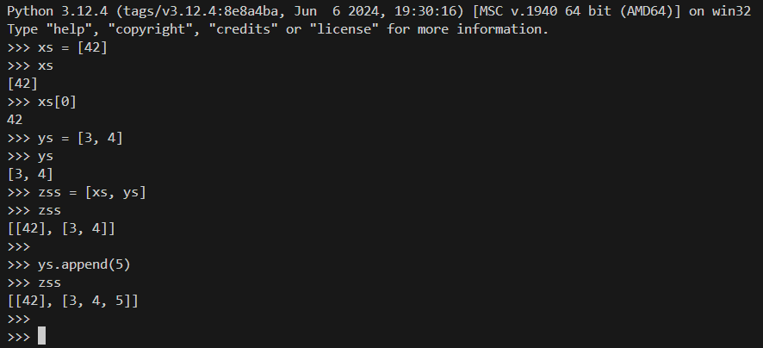
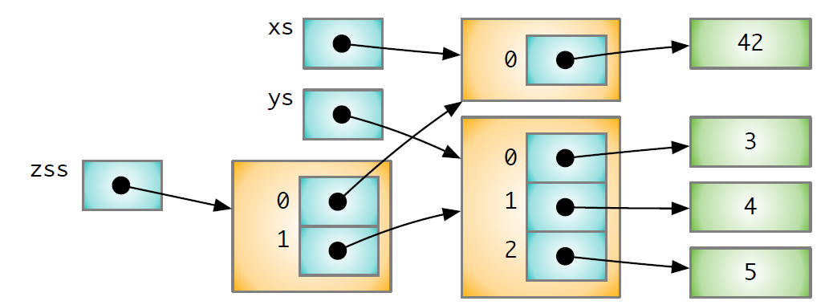
collections and references

Slide 39
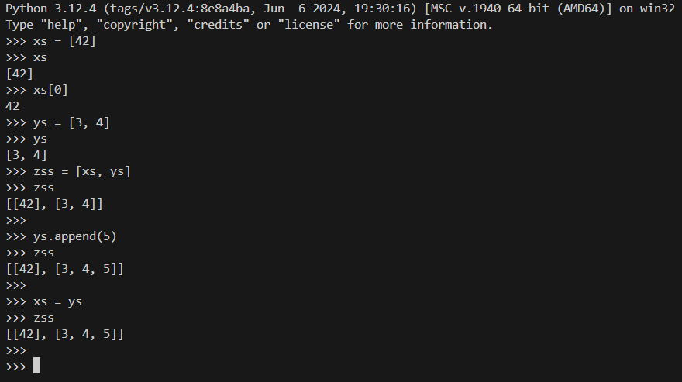
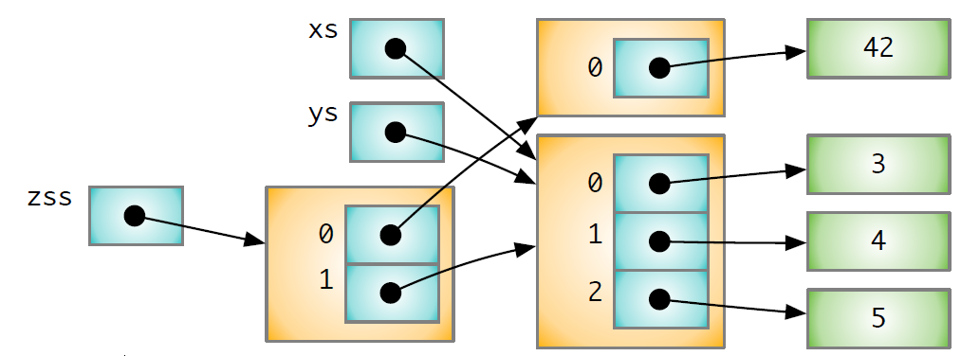
collections and references
Demo code example of dictionary

Slide 40
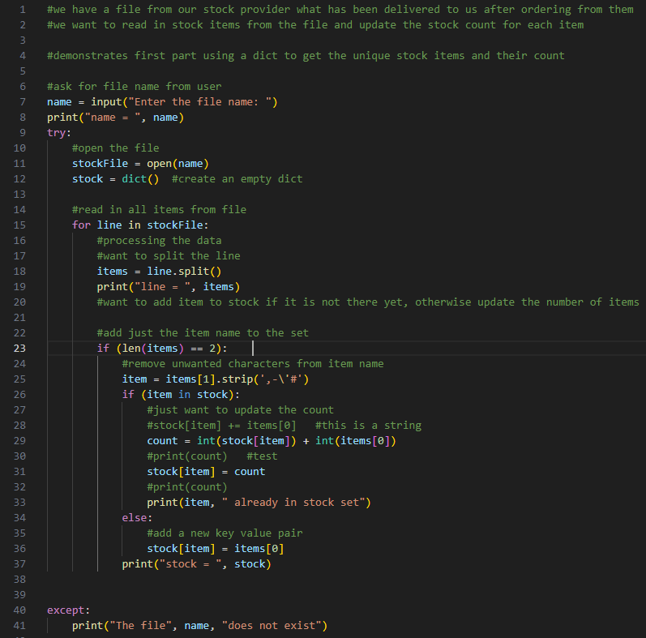
using dictionaries in python
Solving this problem using different collections
stockArrival2.txt

Slide 41
Any questions?
Type your question in the Q&A or raise your hand

Slide 42
Temperature Check
How do you feel about dictionaries?

